Slide 1
HOW TO GET INTO MEDICAL SCHOOL SEMINAR
Presenters:
Alireza Tavakoli & Sepehr Bahrami
Slides will be available on the SOS website

Slide 2
HOW TO GET INTO MEDICAL SCHOOL SEMINAR
DISCLAIMER
The information provided in this seminar gives some
background information about the medical school application process. This is based on information provided by the medical school websites, OMSAS, and the AAMC. Any experiences given by the presenters or guest speaker may not reﬂect experiences shared by others. They are here to deliver the presentation, answer any questions, and provide support.
2

Slide 3
WHO ARE WE?
Alireza Tavakoli
3rd Year Biomedical Science
Email: alirezaj@my.yorku.ca
Sepehr Bahrami
3rd Biomedical Science
Email: sepibhm@my.yorku.ca
3

Slide 4
DIFFERENT TYPES OF PHYSICIANS
Source: https://www.aamc.org/cim/specialty/exploreoptions/list/
Primary Care (Pediatricians, Family Practitioners, and General Internists)
Surgeons (General, Orthopaedic, Plastic, etc.)
Specialist (Dermatologist, Cardiologist, Psychiatrist, etc.)
4

Slide 5
HOW MUCH EDUCATION DOES IT TAKE TO BECOME A DOCTOR?
Typically takes 10 to 16 years
Undergraduate Studies
Medical School
Residency Training*
(Three to four years)
(Four years)
(Three to eight years)*
*Includes Fellowship which varies depending on specialty area
5

Slide 6
WHAT IS THE LIFESTYLE LIKE?
* Work hours vary between specialties
* Generally, family doctors work 35-40 hours a week. Specialists might work similar hours, but have a fixed schedule.
* Lifestyle varies depending on specialty:
Surgical specialties are typically “on call”

Slide 7
AGENDA FOR THIS EVENING
Extra-­curricular Involvement
Medical College Admissions Test (MCAT)
OMSAS Application System
Admission Requirements (Ontario)
Interviews

Slide 8
EXTRA CURRICULAR OPPORTUNITIES
Research Opportunities
RAY (Research @ York)
Work-study positions with professors
Research at Hospitals
Volunteer Opportunities
Shadowing Doctors
Community Involvement
Clubs and Organizations at YorkU
* Leadership Positions
* Sports and hobbies

Slide 9
MCAT
Source: https://students-residents.aamc.org/applying-medical-school/article/whats-mcat-exam/#bb
Computer-based exam
230 multiple choice questions
7 hours 30 minutes with breaks
Tests knowledge in these four sections:
Chemical and Physical Foundations of Biological Systems
Critical Analysis and Reasoning Skills (CARS)
Biological and Biochemical Foundations of Living Systems
Psychological, Social and Biological Foundations of Behavior

Slide 10
MCAT: BREAKDOWN
Source: https://students-residents.aamc.org/applying-medical-school/article/whats-mcat-exam/#bb
Three science sections
59 items, 95 minutes each
10 Passages with 4-­6 questions
15 stand-­alone questions (the questions are not based on passage)
CARS Section
53 items, 90 minutes
9 passages with 5-7 questions
No stand-alone questions

Slide 11
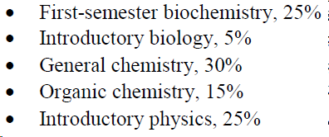
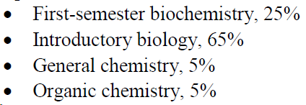
MCAT: BREAKDOWN
Source: https://students-residents.aamc.org/applying-medical-school/article/whats-mcat-exam/#bb
Chemical and Physical Foundations of Biological Systems
2. Critical Analysis and Reasoning Skills (CARS)
*CARS does not test on specific knowledge or additional coursework.
3. Biological and Biochemical Foundations of Living Systems
4. Psychological, Social and Biological Foundations of Behavior

Slide 12
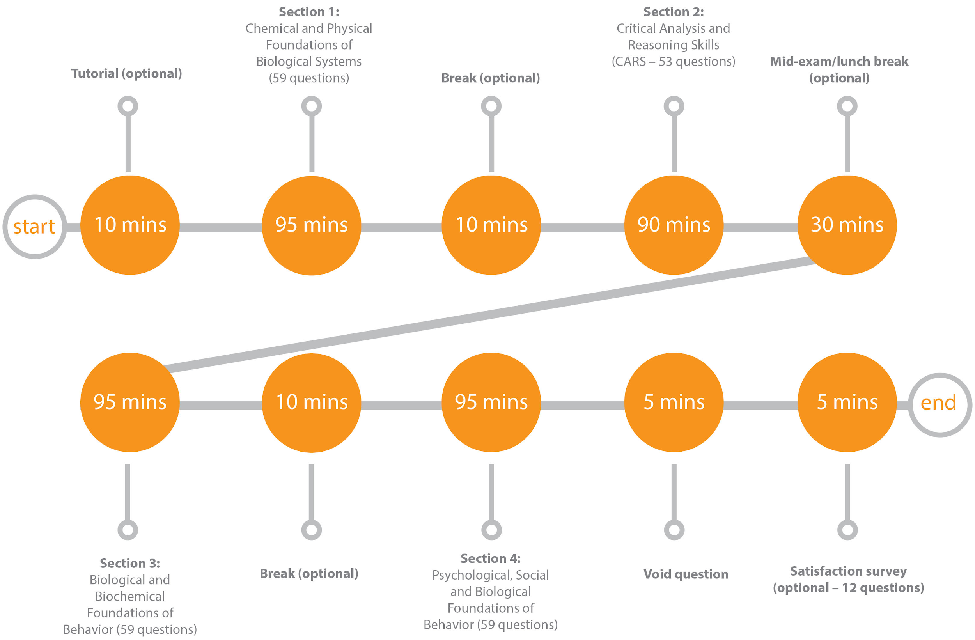
MCAT: Day Schedule
Source: https://www.mcat-prep.com/what-is-the-mcat/#

Slide 13
MCAT: SCORING SCALE
Source:
https://students-residents.aamc.org/applying-medical-school/article/mcat-exam-score-scale/

Slide 14
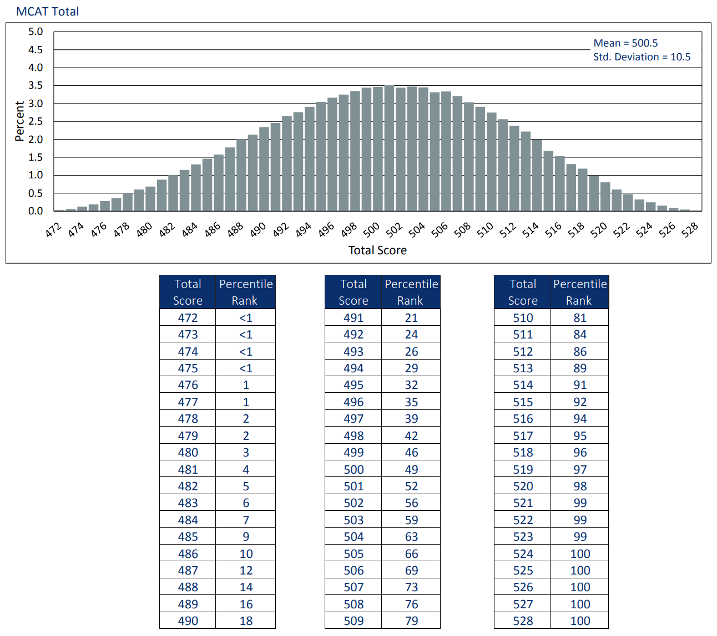
MCAT: SCORING SCALE
Source:
https://students-residents.aamc.org/advisors/article/percentile-ranks-for-the-mcat-exam/

Slide 15
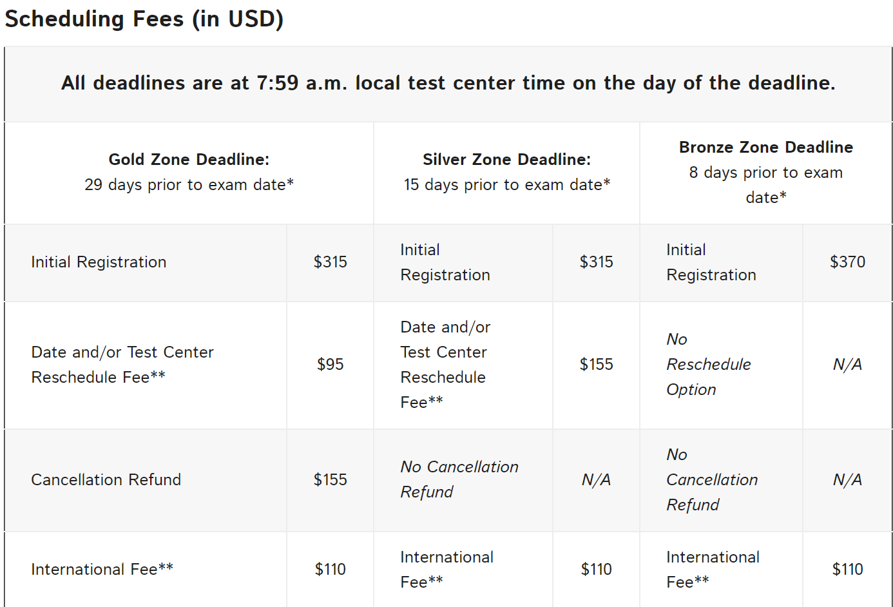
MCAT: ADMINISTRATION
16

Slide 16
MCAT: PREPARATION
https://www.aamc.org/students/applying/mcat/ mcat2015/preparing/265992/preparation.html
Available on the AAMC website:
Practice tests (1 sample test + 3 practice tests)
Khan Academy MCAT Collection
Textbook list for Psychology and Sociology
Preparation Courses (Kaplan, Princeton, Examcrackers Courses)
Preparation Books (Kaplan, Examcrackers Textbooks, Princeton, Berkeley Review)

Slide 17
MCAT: FREQUENTLY ASKED QUESTIONS
How many times can I write the MCAT?
The MCAT can be written:
3 times in a single testing year
4 times in a two consecutive­‐year period
7 times in a lifetime
Note: AAMC has changed the testing centers from Prometric to Pearson.

Slide 18
MCAT: FREQUENTLY ASKED QUESTIONS
Voiding your exam
Wrote exam but don’t want it to be marked
This option given at the end of the exam
Not visible to schools
No refund
Still considered an attempt (out of 7 lifetime attempts)

Slide 19
OMSAS
* Ontario Medical School Application Service
* Application Service Fee: $220
* Additional institutional fees apply (University fee,
$12 per transcript)
Deadlines:
Applications opened: July 2019
Registration Deadline: Sept 15 *2019
Application Submission Deadline: Oct 1 *2019
Interview: Late Feb to Late Mar
Oﬀers of Admission around May
22

Slide 20
SCHOOLS IN ONTARIO
McMaster University -­‐-­‐-­‐ $125
University of Toronto -­‐-­‐-­‐ $130
University of Western Ontario -­‐-­‐-­‐ $125
Northern Ontario School of Medicine -­‐-­‐-­‐ $100
University of Ottawa -­‐-­‐-­‐ $125
Queen’s University -­‐-­‐-­‐ $125

Slide 21
OMSAS
Autobiographical Sketch
Who are you?
Employment
Volunteer activities
Extracurricular activities
Awards and accomplishments
Research
Other
* Note: Only Activities From Age 16+
23

Slide 22
OMSAS
3 confidential forms/references needed for applications to all Ontario medical schools.
Only need to be submitted once per application cycle

Slide 23
Undergraduate Grading System Conversion Table
GPA Conversion Table
Eche/les de notatio.n au premier cycle
Type Scale | Numeric/Numl5rique |  | Percentage/Pourcentage |  |  |  |  |  | Alpha/Alpha
 | 1 | 2 | 3 | 4 |  | 5 | 6 |  | 7 | 8 |  | 9
OMSAS Value Valeur OMSAS |  |  |  |  |  |  |  |  |  |  |  |  | OMSAS Value Valeur OMSAS
4.00 | 9 | 8 | 90-100 | 93-100 |  | 94-100 | 94-100 |  | A+ | A |  | A+ | 4.00
3.90 |  |  | 85-89 | 84-92 |  | 87-93 | 85-93 |  | A |  |  |  | 3.90
3.80 |  |  |  |  |  |  |  |  |  |  |  | A | 3.80
3.70 | 8 | 7 | 80-84 | 75-83 |  | 80-86 | 80-84 |  | A- | A- |  |  | 3.70
3.30 | 7 | 6 | 77-79 | 72-74 |  | 75-79 | 75-79 |  | B+ | B+ |  | B+ | 3.30
3.00 |  |  | 73-76 | 69-71 |  | 70-74 | 70-74 |  | B | B |  | B | 3.00
2.70 | 6 | 5 | 70-72 | 66-68 |  | 65-69 | 65-69 |  | 8- | 8- |  |  | 2.70
2.30 | 5 | 4 | 67-69 | 64-65 |  | 60-64 | 60-64 |  | C+ | C+ |  | C+ | 2.30
2.00 |  |  | 63=66 | 62=63 |  | 55=59 | 55=59 |  | c | c |  | c | 2.00
1.70 | 4 | 3 | 60-62 | 60-61 |  | 50-54 |  |  | c- | c- |  |  | 1.70
1.30 |  | 2 | 57-59 | 56-59 |  |  |  |  | D"' | D+ |  | D+ | 1.30
1.00 |  |  | 53-56 | 53-55 |  |  | 50-54 |  | D | D |  | D | 1.00
0.70 |  |  | 50-52 | 50-52 |  |  |  |  | D- | D- |  |  | 0.70
0.00 | 3 | 1 | .s. 49 | .s. 49 |  | .s. 49 | .s. 49 |  | E/F | E/F |  | E/F | 0.00
Acadia | 7 | Guelph | 3 |  | Mt. A llsi on |  | 7 | Ryerson |  |  | 7 | Trni ity Western USC UNBC UOIT V ci tor ai Waterol o Western Wiflrid Laurier Windsor Winnipeg York |  |  | 7 7 7 7 3..7 3..7 3 7 3.7 7 9
Alberta | 7 | Lakehead | 3 |  | Mt. St. V incent |  | 7 | Saskatchewa n |  |  | 3
Algoma | 3 | Laurentian | 3,7 |  | New Brunswick |  | 7 | Sherbrooke |  |  | 7
Athabasca | 7 | Laval | 7 |  | Nipissing |  | 3 | Smi on Fraser |  |  | 7
Bsi hop's Brandon Brock | 3 7 3 | Lethbridge Mantioba McGill | 7 9 B |  | Ottawa Prince Edward Isal nd Quebec |  | 7 3 7 | St. Francis Xavei r St. Mary's St. Thomas |  |  | 3 7 7
Calgary | 7 | McMaster | 7 |  | Queen's |  | 7 | Ste-Anne |  |  | 7
Cape Breton Car el ton | 3 7 | Memorai l Moncton | 6 7 |  | Regina RMCC/CMRC |  | 3 4,7 | Thompson Rvi ers Toronto |  |  | 7 3,7
Concordai Dalhousei | 7 3,7 | Montreal | 7 |  | Royal Roads |  | 7 | Trent |  |  | 3

Slide 24
MCMASTER UNIVERSITY
Michael G. DeGroote School of Medicine

Slide 25
MCMASTER UNIVERSITY- ACADEMIC REQUIREMENTS
Source: https://mdprogram.mcmaster.ca/md-program-admissions/who-should-apply/additional-notes-on-academic-requirements
Minimum of 3 years of undergraduate work
90 credits (full course load not required)
Prerequisites: None
205/5228 applicants admitted to the Class of 2022
GPA cutoﬀ: 3.0 (Cumulative)
MCAT cutoﬀ: CARS 123
CASPer (Computer-­based Assessment for Sampling Personal characteristics)
Assessment of interpersonal skills and decision‐making
90 minutes
27

Slide 26
UNIVERSITY OF TORONTO

Slide 27
UNIVERSITY OF TORONTO (ACADEMIC REQUIREMENTS)
Sources:
http://applymd.utoronto.ca/academic-requirements
http://applymd.utoronto.ca/admission-stats
Minimum of 3 years of undergraduate work
90 credits (weighting formula for full course load)
28 credits is a full course load
GPA cutoﬀ: 3.6/4 (Summer Courses do not count)
MCAT cutoﬀ: 125 in each of the four sections
Accepts International Students
639/3265 students interviewed in 2018

Slide 28
UNIVERSITY OF TORONTO (COURSE PREREQUISITES)
Source:
http://applymd.utoronto.ca/prerequisite-courses
Required
2 full course equivalents in Life Sciences
* Examples: Biology, Anatomy, Biochemistry, SC/KINE courses, etc.
1 full course equivalent in humanities/social science/language
Recommended
Course in Statistics
http://md.utoronto.ca/prerequisite-course-requirements

Slide 29
UNIVERSITY OF TORONTO (NON-ACADEMIC REQUIREMENTS)
Source:
http://applymd.utoronto.ca/non-academic-requirements
3 statements (250 words or less) outlining three activities and/or achievements from your OMSAS autobiographical sketch

Slide 30
UNIVERSITY OF TORONTO (NON-­ACADEMIC REQUIREMENTS)
Source:
http://applymd.utoronto.ca/non-academic-requirements
Personal Essays
4 essays (250 words or less) (May vary year to year)
* Example questions (not 2019-2020 questions)
Question 1: Physician and author Abraham Verghese argues that the most important innovation to come in medicine in the next 10 years is human touch. Discuss.
Question 2: How does technology impact interactions and or collaborative relationships among healthcare professionals?
Question 3: Describe an example of injustice that matters to you. How would a career in medicine allow you to be a better advocate in similar circumstances?
Question 4: What is your preferred style of learning? How has this impacted your educational development?

Slide 31
WESTERN UNIVERSITY
(UNIVERSITY OF WESTERN ONTARIO)
Schulich School of Medicine

Slide 32
WESTERN UNIVERSITY- ACADEMIC REQUIREMENTS
4 year undergraduate degree
120 credits
Prerequisites: none
GPA cutoﬀ: 3.70
Calculated from the 2 best years with full course load
60% course load should be at the level of that year of study or higher
GPA minimum must be met in EACH of the 2 best years
MCAT cutoﬀ (varies annually)
Bio/Biochem Section 126, Chem/Orgo/Biochem Section 126, Cars 128

Slide 33
NORTHERN ONTARIO SCHOOL OF MEDICINE

Slide 34
NORTHERN ONTARIO SCHOOL OF MEDICINE
ACADEMIC REQUIREMENTS
4 year undergraduate degree
120 credits
Prerequisites: none
Recommended
Science majors: 2 full course equivalents in arts/social sciences /humanities
Art/social science/humanities majors: 2 full course equivalents in science
GPA cutoﬀ: 3.0
Cumulative
MCAT: not required
Conﬁdential Assessment Forms

Slide 35
NORTHERN ONTARIO SCHOOL OF MEDICINE NON-ACADEMIC REQUIREMENTS
Autobiographical Sketch
The Autobiographical Sketch is a detailed and comprehensive list of your activities since age 16, within any of the following categories:
E: Employment
V: Volunteer Activities
X: Extracurricular Activities
A: Awards and Accomplishments
R: Research
O: Other

Slide 36
UNIVERSITY OF OTTAWA

Slide 37
UNIVERSITY OF OTTAWA
Source:
https://med.uottawa.ca/undergraduate/admissions/application-process/excellence-marks
Academic Requirements
Minimum of 3 years of undergraduate work
90 credits (full course load required)
GPA cutoﬀ: 3.5 (WGPA)
The most recent 3 years (full course load)
First year multiplied by a factor of 1, second year by a factor of 2, and the third year by a factor of 3
MCAT: not required

Slide 38
UNIVERSITY OF OTTAWA (PREREQUISITES)
Source:
https://med.uottawa.ca/undergraduate/admissions/application-process/eligibility-requirements
Prerequisites
6 credits equivalent Biology or Physiology
6 credits equivalent in Humanities/Social Science
12 credit equivalents in the following:
3 credits in Biochemistry (without lab); BIOL 2020 or CHEM2050
3 credits in Chemistry (with lab); CHEM 1000 & 1001
3 credits in Organic Chemistry (with lab); CHEM 2020 & 2021
6 credits of Lab requirement; either from above courses or optional courses with lab component.
Courses taken in summer sessions are not added to the GPA calculation.

Slide 39
UNIVERSITY OF OTTAWA (NON-­ACADEMIC REQUIREMENTS)
CASPer (Computer-­based Assessment for Sampling Personal Characteristics)
Assessment of interpersonal skills and decision-making
90 minutes
www.takecasper.com

Slide 40
QUEEN’S UNIVERSITY

Slide 41
QUEEN’S UNIVERSITY- ACADEMIC REQUIREMENTS
Minimum of 3 years of undergraduate work
90 credits
Prerequisites: none
GPA cutoﬀ: varies from year to year
2 GPAs are calculated
Cumulative GPA (CGPA) -­ Summer Courses included
Most recent two full-time years GPA (2YGPA) -­ Summer Courses do not count
At least 3 courses per semester (considered full course load)
MCAT cutoff: varies from year to year:
No longer accepting scores from the old MCAT

Slide 42
SCHOOLS IN CANADA
Dalhousie University
McGill University
Memorial University of Newfoundland
Université Laval
University of Alberta
University of Calgary
University of Manitoba
University of Montreal
University of Saskatchewan
University of Sherbrooke
* University of British Columbia

Slide 43
SCHOOLS IN THE UNITED STATES
179 medical schools in the United States
This includes 36 DO schools (different from allopathic schools)
School speciﬁc requirements:
Most schools also need Physics and English
Apply via AMCAS
https://services.aamc.org/30/msar

Slide 44
INTERVIEWS
Assessing your personal qualities
Personal qualities ‐ Maturity
Personal experiences and interests
Exposure to healthcare and medical research environments
Potential contributions to the campus and community
Ability to communicate

Slide 45
PREPARATION
Plan your trip carefully
Dress accordingly to weather
Dress comfortable
Practice common questions
Know your application
Be honest and sincere
Be ready to discuss your research in layman’s terms
Thank everyone who helped

Slide 46
TRADITIONAL (PANEL) INTERVIEWS
More than one interviewer interviews you the same time
May be interviewed with other candidates together
Interviewers can be faculty, students, admission oﬃcer
May be open ﬁle, blind or partial blind (The reviewing of applicant’s ﬁle before interviews)

Slide 47
MULTIPLE MINI INTERVIEW (MMI) FORMAT
10-­station circuit
Each station lasts 10 minutes with a 2-­minute break between stations
Topics may include:
ethical decision making
critical thinking
personal
communication skills
knowledge of the healthcare system
51

Slide 48
MPI MULTIPLE PERSONAL INTERVIVIWS
UofT uses this format
Mixed between the two type of traditional and MMI
4 Stations- Each about 12 minutes
Have 4 chances to make the first impression
Have the chance to be conversational

Slide 49
GUEST SPEAKER
Brian Serapio
Former York University Student
Current 2st Year Medical Student at University of Toronto

Slide 50
QUESTIONS?
bethune.yorku.ca/events/
Alireza Tavakoli: alirezaj@my.yorku.ca
Sepehr Bahrami: sepibhm@my.yorku.ca

Slide 51
UPCOMING SEMINARS
How to get into Pharmacy School
Wednesday September 25th at 5:30 pm in BC 320
How to get into Dental School
Wednesday October 2nd at 5:30 pm in BC 320

Slide 52
REFERENCES
http://www.ouac.on.ca/omsas/
https://www.aamc.org/students/applying/mcat/mcat2015/
https://meds.queensu.ca/academics/undergraduate/prospective-students/applying/method-selection
http://ts.mcmaster.ca/mdprog/
http://www.md.utoronto.ca/admissions.htm
http://www.schulich.uwo.ca/medicine/undergraduate/future_students/ admission/requirements.html
http://www.nosm.ca/education/ume/general.aspx?id=390
http://med.uottawa.ca/undergraduate/admissions/application-­process

