Slide 1
Applying to Veterinary
School
A Presentation by Bethune College SOS
http://bethune.yorku.ca/sos/

Slide 2
General Information
There are 5 veterinary schools in Canada. Students must apply to the Veterinary College in their region of residency. The OVC at Guelph serves Ontario.
Each school has its own relatively unique methods of selection.
The rules change yearly.
http://bethune.yorku.ca/sos/

Slide 3
Schools in Canada
Ontario Veterinary College
University of Guelph
Serves Ontario
Atlantic Veterinary College
University of Prince Edward Island
Serves the 4 Atlantic provinces &
territories
Faculty of Veterinary Medicine
University of Calgary
Serves Alberta
http://bethune.yorku.ca/sos/

Slide 4
Schools in Canada (cont’d)
Western College of Veterinary
Medicine
University of Saskatchewan
Serves 4 western provinces &
territories
Faculté de médecine vétérinaire
Université de Montréal (Francophone)
Serves Québec
http://bethune.yorku.ca/sos/

Slide 5
Ontario Veterinary College @ University of
Guelph
Interview invite is based on:
GPA (last four 15.0-credit semesters & prerequisites
GPA)
Practical experience and extracurricular involvement
Final Acceptance is based on:
Combined GPA
Interview Score on the Multiple Mini Interview (MMI)
Notes:
*Pass/fail system for the supplementary application

Slide 6
Admission Requirements:
Academic:
At least 2 years of 100% course load (15.0 credits/semester) undergraduate education in a university science program
Prerequisite Courses:
2 Biological Sciences (recommended emphasis on animal biology) = 6 credits
Cell biology = 3 credits
Genetics = 3 credits
Biochemistry = 3 credits
Statistics = 3 credits
2 Humanities/social sciences = 6 credits
(more details at http://www.ovc.uoguelph.ca/recruitment/en/applyingtodvm/Academicrequirements.asp )
Notes:
You need to take 15 credits per semester and prerequisite courses also have to be taken within those semesters (i.e no summer courses?)
There is a list of acceptable courses on the website if you are not sure what qualifies for humanities
*Prerequisite courses must go through a “course approval” process - basically just email OVC with description

Slide 7
Admission Requirements:
Academic (cont’d):
The GPA from your last two full-time semesters, as well as the average of your 8 prerequisite courses must be ≥7.0 (B+) on York’s 9-point scale.
MCAT
Note: The MCAT is no longer required for applicants to the DVM program, beginning with applications for Fall 2016 entry.
Notes:
The GPA from your last two full-time semesters, as well as the average of your 8 prerequisite courses must be ≥7.0 (B+) on York’s 9-point scale for your application to be further considered
PASS/Fail courses are not evaluated and all courses considered should have a letter or numerical grade
*Score formed by -> 50% last 10 courses, 50% 8 prereqs

Slide 8
Admission Requirements:
Non-academic:
Undergraduate Student
3 Referee Assessments (reference
letters)
Two of the three referees selected must be veterinarians with whom you have obtained veterinary and/or animal experience.
Graduate Student
Two of the four referees selected must be veterinarians
Notes:
--> Your reference letter must be on letterhead, addressed to the Chair, OVC Admissions Committee and signed.
-->The Admission Committee strongly suggests that the 2 refernce letters you get from vets be from different clinics or workplaces. They would like to know how others in the profession think of your potential of becoming a vet.
→ Referee must have a professional relationship with you. Cannot be employed
→Your three confidential referee assessments include an evaluative grid and a letter. Applicants will provide their referees' contact information when they submit their Background Information Form in January. The referees will then be contacted directly and asked to fill in an online referee assessment by March 1st.
→ Other 2 must be should be from persons familiar with your performance as a graduate student

Slide 9
Admission Requirements:
Non-academic (cont’d):
Background Information Form (BIF):
Personal statement
Series of questions exploring your understanding and motivation
Animal Experience
Pet store, work with livestock, breeding program, etc. A vet does not have to be present.
Veterinary Experience
Volunteer or paid; supervised by a vet.
Extracurricular experience
Jobs & volunteer activities that hone your communication, interpersonal and organizational skills.
Notes:
*This BIF no longer asks “why you want to become a vet”, it’s another list of questions instead.

Slide 10
Application Process
DUE DECEMBER 1:
Canadians with Ontario residency: If you attend a post-secondary institution other than the University of Guelph OR are living abroad, apply to the DVM program using the OUAC 105D form online at the Compass website.
Notes:
→OUAC 105D form online at the Compass website and can be found under the University of Guelph undergraduate degree programs page

Slide 11
Application Process (cont’d)
DUE FEBRUARY 1:
Background Information Form (BIF)
DUE MARCH 1:
Referee Assessments
Transcripts
Notes:
The BIF will now be submitted online from this year (2016 application cycle)
You will be responsible for submitting your referee assesments i.e your 3 letters
**I think the deadline to submit the app through OUAC is December 1st this year - double check

Slide 12
Selection Process
1. Calculation of Admission Average - March
A 50:50 ratio determines admission average (50% GPA of last 2 acceptable semesters, 50% GPA of prerequisite courses).
Top candidates move on in the selection process.
2. Review of Applications - March-April
The OVC admissions committee reviews the applications of the top applicants to verify that they are suitable for interviews.
Notes:
The Admission average narrows down applicants and allows the admissions board to select the top applicants.

Slide 13
Selection Process (cont’d)
3. Interview (MMI format) – May
Candidates rotate through a series of 8 stations. At each station, there is a scenario that the candidate must interpret for assessors who evaluate the student based on a scoring rubric.
4. Final review of interviewed applicants - early
June
The top 100 students chosen after admission committee
reviews.
5. Communication of decision
An official letter will be mailed to each applicant.
Class of 2018 Stat Sheet
http://www.ovc.uoguelph.ca/recruitment/en/applyingtodvm/resources/Stats-for-2018-entry-cycle.pdf
Notes:
MMI station is about 10 min each
***1 of the 8 stations is a background station -> They ask you about your experince, why you want to be a vet, how you handle certain things et
The interview score becomes 35% of the final ranking and is combined with the admissions average calculated in step 1 above (which is now 65%). The top 200 applicants are re-ranked with the combined score.

Slide 14
Atlantic Veterinary College @ University of
Prince Edward Island
4 Year Program, 63 students
Distinct Applicant Pools:
Approx. 2/3 of seats reserved for Atlantic students from PEI, Nova Scotia, New Brunswick & Newfoundland and Labrador
The last pool is allocated to international applicants including those from the US
Notes:
Canadians who aren’t permanent residents in the Atlantic pool cannot apply. Must look at the Vet school in their region

Slide 15
Atlantic Veterinary College @ University of
Prince Edward Island
Selection Criteria (out of 100% overall admissions
score):
60% Academic:
50% weighed academic average
10% General Graduate Record Examination
40% Non-academic:
20% work and school approach and behaviour test score
20% veterinary, animal, employment,
and community experiences & Interview

Slide 16
Prerequisite Courses (Fall 2019):
Science
Animal Biology 1 Animal Biology 2 Animal Biology 3 Genetics Mathematics 1 Mathematics 2 (Statistics) Chemistry 1 Chemistry 2 Chemistry 3 (Organic Chemistry)
Non Science: English (Composition)
Academic Average = 50% (Average of 10 prescribed courses) + 50% (Average of most recent two full time semesters, Sept – April)
More about prerequisite courses criteria at
http://www.upei.ca/programsandcourses/professional-programs/doctor-veterinary-medicine/dvm-academic-requirements

Slide 17
Admission Requirements (cont’d):
Non-academic (40%) :
Work and School Approach and Behaviour Test (20%)
A personality inventory
Evaluate critical approaches and behaviours found in daily and professional situations
Not possible to study for this
Employment Experience, Honours and Awards, and
Community Activities (20%)
Applicants are asked to submit structured and detailed descriptions of their employment, honours and awards, and extracurricular and community activities.

Slide 18
Admission Requirements:
Non-academic:
Interview
Only those applicants who rank highly based on their academic achievement (weighted academic average and GRE score) invited to interview.
Interview will draw on applicant’s experiences to discuss how they have contributed to their understanding of the veterinary profession

Slide 19
Admission Requirements (cont’d):
Non-academic:
Looking for specific skills:
Observation
Communication
Motor Skills
Intellectual Conceptual, Integrative and Quantitative Abilities
Behavioural and Social Attributes
http://www.upei.ca/programsandcourses/professional-programs/doctor-veterinary-medicine/dvm-non-academic-requirements

Slide 20
University of Calgary- Faculty of Veterinary Medicine
Students must be Alberta residents, as defined by the Province of Alberta. To be eligible for admission to UCVM, you must be an Alberta resident.
The Faculty of Veterinary Medicine accepts 30-32 DVM students per year. The Admissions Committee recommends students for admission to the program on the basis of academic and non-academic factors.
http://vet.ucalgary.ca/dvmadmissions#quickset-field_collection_quicktabs_2

Slide 21
University of Calgary- Faculty of Veterinary Medicine
Academic Requirements
A minimum overall average of 3.00 ("B" or its equivalent) with a passing grade in each of the required courses
Once this requirement has been met, the average GPA from the required courses will not be used further in the admissions process.
You must have completed or be in the process of completing the TEN (10) required courses with at least SEVEN (7) of the TEN (10) required courses being completed before December 31, 2019.

Slide 22
University of Calgary- Faculty of Veterinary Medicine
Academic Requirements
UCVM defines a “full time” term as a minimum of FOUR (4) ‘first-attempt’ courses per term (semester)
A minimum combined grade point average (GPA) of 3.00 ("B" or its equivalent) over EACH of the last four full-time terms of undergraduate academic years.

Slide 23
University of Calgary- Faculty of Veterinary Medicine
Required Courses
Two Introductory Biology Courses (a lab component is required for each course)
Two Introductory Chemistry Courses (a lab component is required for each course)
One Introductory English Course (must contain a writing component)
One Introductory Organic Chemistry Course (a lab component is required)
One Introductory Statistics Course
One Introductory Biochemistry Course (a lab component is optional)
One Introductory Genetics Course (a lab component is optional)
One Introductory Ecology Course (a lab component is optional)

Slide 24
University of Calgary- Faculty of Veterinary Medicine
A complete application consists of:
The completed application form
The application fee
Post-secondary transcripts submitted by the appropriate academic institutions
Proof of Alberta residency
Signed Declaration of the applicant
Interview style is MMI

Slide 25
Western College of Veterinary Medicine @
University of Saskatchewan
WCVM serves the four western provinces of British Columbia, Saskatchewan and Manitoba, as well as the territories of Yukon, Northwest Territories and Nunavut. Must be a Resident.
BC: 20 seats
Saskatchewan: 20 seats
Manitoba: 15 seats
Territories: 1
Education Equity Program*: 2
Notes:
*Indigenous Equity Access Program: Each year, two seats are available for Indigenous students through the Education Equity Program. Applicants must meet residency requirements of British Columbia, Saskatchewan, Manitoba or the northern territories.

Slide 26
Western College of Veterinary Medicine @ University of Saskatchewan
4 Year Program, 58 Students
Applicants must meet residency requirements
Non-Academic:
Structured Interview – assess applicant’s ability to cope with the veterinary program & evaluate non-academic qualities
Referees evaluation are also used to assess these non-academic qualities

Slide 27
General Admission Requirements
You must be a Western Province/Territory resident with Canadian citizenship or permanent resident status
GPA from the last four full-time terms (min. 12.0 credits) as of January will be calculated.
You must have completed or be in the process of completing the 10 required courses. Required courses may not be repeated more than once for consideration.

Slide 28
Academic Admission Requirements
The Faculty of Veterinary Medicine considers applicants from a variety of educational backgrounds. No preference is given to any particular program, college or university. A minimum, cumulative average of 75 per cent is needed to be considered for admission.
Required Undergraduate Courses:
6 Credits of Biology 6 Credits of Chemistry 6 Credits of English 6 Credits of Mathematics/Statistics 3 Credits of Organic Chemistry 3 Credits of Physics 3 Credits of Biochemistry 3 Credits of Genetics 3 Credits of Microbiology 21 Elective Courses

Slide 29
Faculté de médecine vétérinaire-Université de Montréal
To attend this school you must be proficient in French, due to all the classes being taught in this language
For more information: http://www.medvet.umontreal.ca/

Slide 30
More about your Veterinary School
Application
http://bethune.yorku.ca/sos/

Slide 31
Prepare Yourself
You must take an active interest in learning and keeping up with the admissions policies at your targeted schools
You have to plan in advance your approach
Don’t count on any one particular school’s policies to help you – remember luck plays a role and policies change.
Of all things, GPA is usually the primary barrier for most applicants and is the hardest to improve
http://bethune.yorku.ca/sos/

Slide 32
Questions?
Tanya - Tanraj13@my.yorku.ca
Sebastian - sdavid11@my.yorku.ca
http://bethune.yorku.ca/sos/

Slide 33
Brittany Solomon, BSc
OVC Phase 1 Student
Class of 2023
Notes:
Intro
State degree
Motivation for being there
Disclaimer

Slide 34
How to Get into OVC
Grades - 65%
Supplementary Application
Interview - 35%
Notes:
By far grades are the most important factor for getting you through the door
Has this person put in enough effort? Have they tried out the profession -> Large Animal, Food Animal**, Small Animal, Research, Government
*Minimum 75% to apply

Slide 35
GRADES

Slide 36
Grade Conversion Chart
York University Letter Grade | OVC Percentage
A+ | 95
A | 85
B+ | 77
B | 72
C+ | 67
C | 62
D+ | 57
D | 52
Notes:
Big advantage to YorkU students

Slide 37
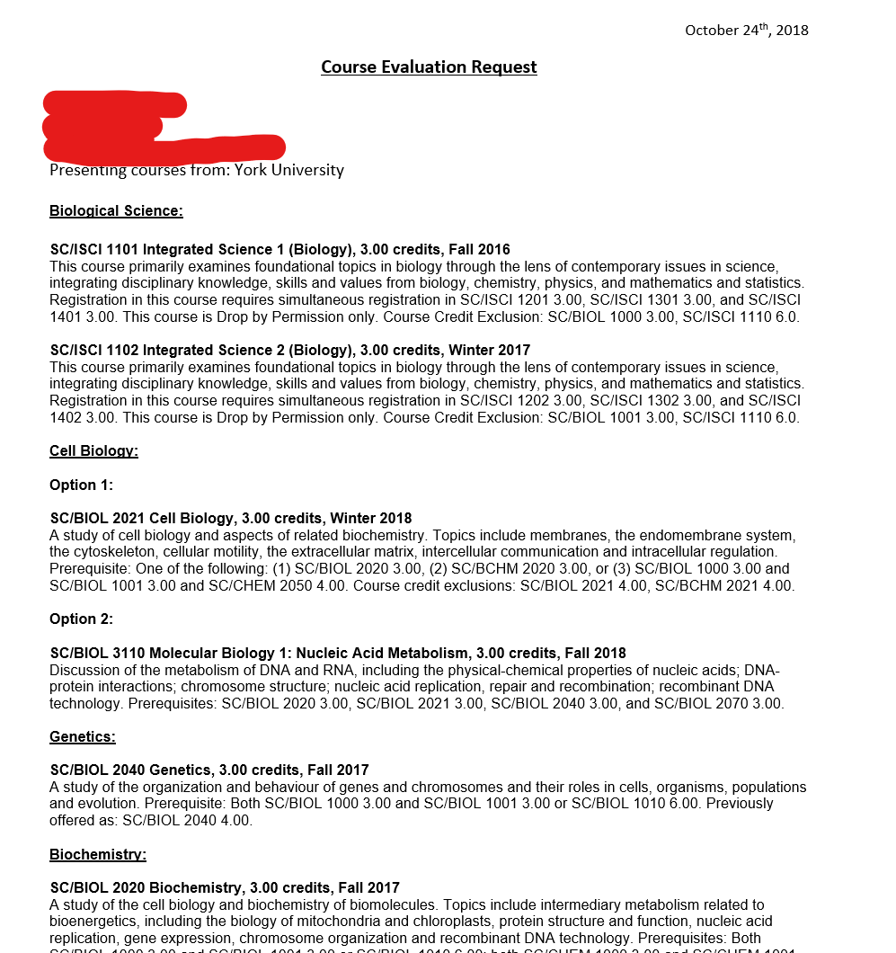
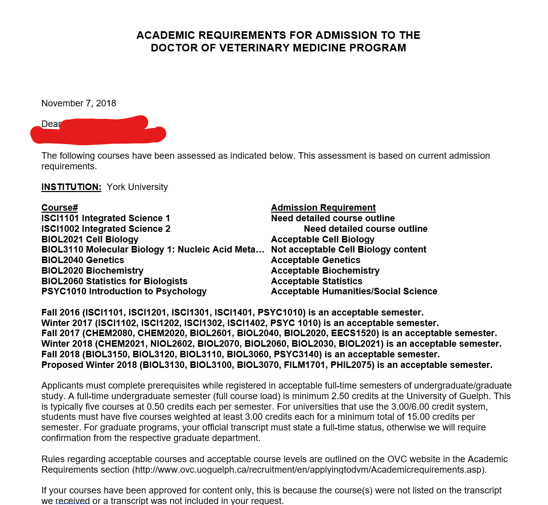
How to Get Courses Approved
Email admdvm@uoguelph.ca to submit your course evaluation requests...
...they will respond with a letter like this
Notes:
Submit as far in advance as you can because they get bogged down with requests closer to important application deadlines, sometimes takes a while to get back to you

Slide 38
How to Get Courses Approved
For more information on the course approval process, as well as academic and other requirements for admission, visit the following website:
http://www.ovc.uoguelph.ca/recruitment/en/applyingtodvm/Academicrequirements.asp
Notes:
REALLY important website!! ALWAYS refer back to it

Slide 39
Approved Courses
Warning: Always have your courses verified by OVC admissions administration - DO NOT just use what worked for us

Slide 40
Approved Courses - Brittany
OVC Requirement | Course Code | Course Name
Biological Sciences I/II | ISCI 1101/1102 | Integrated Science I/II
Cell Biology | BIOL 2021 | Cell Biology
Genetics | BIOL 2040 | Genetics
Statistics | BIOL 2060 | Statistics for Biologists
Biochemistry | BIOL 2020 | Biochemistry
Humanities and Social Sciences I/II | PSYC 1010 | Introduction to Psychology
Also Approved for Humanities: PSYC 3140 Abnormal Psychology
Not Approved for Cell Biology: BIOL 3110 Molecular Biology I

Slide 41
Approved Courses - Mahsa
OVC Requirement | Course Code | Course Name
Biological Sciences I/II | BIOL 1000/1001 | Biology I/II
Cell Biology** | BIOL 2021 | Cell Biology
Genetics | BIOL 2040 | Genetics
Statistics | BIOL 2060 | Statistics for Biologists
Biochemistry | BIOL 2020 | Biochemistry
Humanities and Social Sciences I/II | PSYC 1010 | Introduction to Psychology
**Also Approved for: Histology
**Not Approved: Biology of Cancer, Physiology

Slide 42
Approved Courses - Drago
OVC Requirement | Course Code | Course Name
Biological Sciences I/II | BIOL 3150/KINE 2011 | Microbiology / Human Physiology I
Cell Biology** | BIOL 4061 | Cell & Molecular Biology of Development
Genetics | BIOL 4285 | Human Molecular Genetics
Statistics | PSYC 2022 | Statistical Methods II
Biochemistry | BIOL 3051 | Macromolecules of Biological Interest
Humanities and Social Sciences I/II | ECON 1000/PSYC 3170 | Introduction to Microeconomics/Health Psychology
** BIOL 4270 - Reproduction ⇒ Not acceptable cell biology
** BIOL4220 - Histology ⇒ Acceptable cell biology

Slide 43
Pro Tip...
Phase 1 OVC’s curriculum places heavy focus on...
Anatomy**
Physiology
Histology
Try to take these courses in your undergraduate studies
Notes:
** Anatomy is the biggest help. Thomason making it mandatory?
Put these courses in the semesters you don’t care about - focus more on the learning

Slide 44
Course Semester Criteria
For students in programs with more than 10 credits, 60% of credits in each full-time semester must be taken at a 3000 level (third year level) or above. However, 40% of the credits in a full-time semester may be taken at the level of the applicant's choice.
Courses will not be acceptable if they are repeats of previously passed courses, or if they are taken at the same level or a lower level in a subject area than previously passed courses in the same subject area
Notes:
Please Please read the admission criteria on the website carefully
Admission stats for each year are also provided to give you an idea of where you need to be

Slide 45
THE INTERVIEW

Slide 46
Interview Tips
University of Guelph Future Vets Club
Mock MMI - 4 stations
Join the Facebook Group!
Registration opens ~End of January/Early February
https://www.facebook.com/fvcguelph/
Notes:
Favorite the page so it comes up first on your news feed (can also turn on post notifications)
The exact same place where the real MMIs are -> helps you feel more comfortable in the space during the real interview
Questions on practice MMI are more general. Prepare for animal related questions -> Rollins Ethics Book**

Slide 47
Interview Tips
Start preparing as soon as possible!
PRACTISE PRACTISE PRACTISE WITH OTHERS
Join “YorkU goes to OVC” on Facebook!

Slide 48
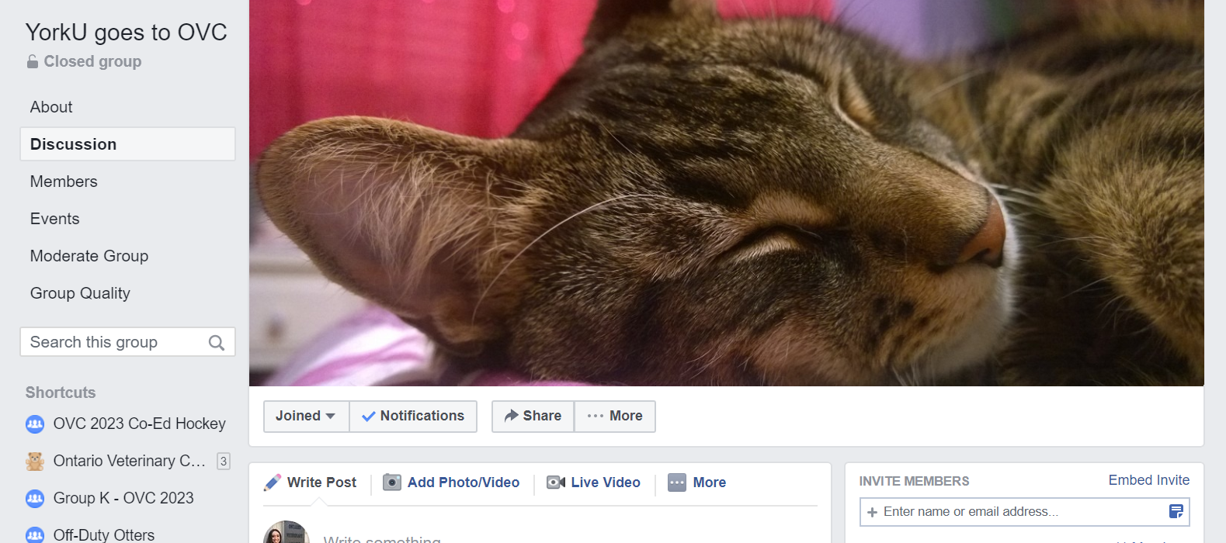
YorkU Goes to OVC
https://www.facebook.com/groups/337415350353915/
Notes:
Everyone take a moment and join now!

Slide 49
Books to Buy/Read
Notes:
Both can be purchased on amazon

Slide 50
FutureMeMD
https://futurememd.com/dds-interview-questions-1
Notes:
FutureMeMD has a great website with lots of helpful resources and tons of practice questions you can also use

Slide 51
MMI Practice Tip
Try recording yourself answering questions so you can watch and critique yourself after!
As uncomfortable as it may feel, it’s the best way to notice your own habits.
Notes:
Examples:
How often do you say filler words such as “like”, “um”, “so”, etc.
How much hand movement do you use
How is your posture
How is your tone of voice/volume
How much eye contact do you make/where are you looking

Slide 52
SUPPLEMENTARY APPLICATION

Slide 53
Categories
Veterinary Experience
Animal Experience
Other Employment Experience
Extracurricular Activities
Honours and Awards
Essay
6 lines for each
Notes:
Within Vet and Animal you have to select the type of animal you worked with

Slide 54
Supplementary Application Tips
Variety
In terms of types of animal experience but also non-animal experience → Show you’re a well-rounded person
Large Animal/Equine experience are helpful in school
Quality over Quantity
Keep track of your hours
Spreadsheet, notebook
Start working on your application over Christmas break (or earlier!)
Notes:
Variety
good to have experience with a variety of animals but NOT MANDATORY - I have some friends in vet school who are terrified of horses and have never touched one before and they still got in
Want to see leadership experiences, interpersonal skills, veterinarians don’t just deal with animals they deal with people too
Spreadsheet SUPER helpful when filling out your BIF - will be asked how many hours you put into each activity & what you did

Slide 55
Getting References & Validators
“Are you willing to write me a POSITIVE reference?”
Ask your referees FAR in advance of the Feb. 1st BIF deadline
You will need a contact name & phone number for every veterinary/animal/extracurricular/employment experience you write on your BIF
Reach out to these people in advance to make sure they can validate that you’ve done what you say you have
Notes:
Asking referees in advance will make you look better but also gives you time to try to find other people if they say no

Slide 56
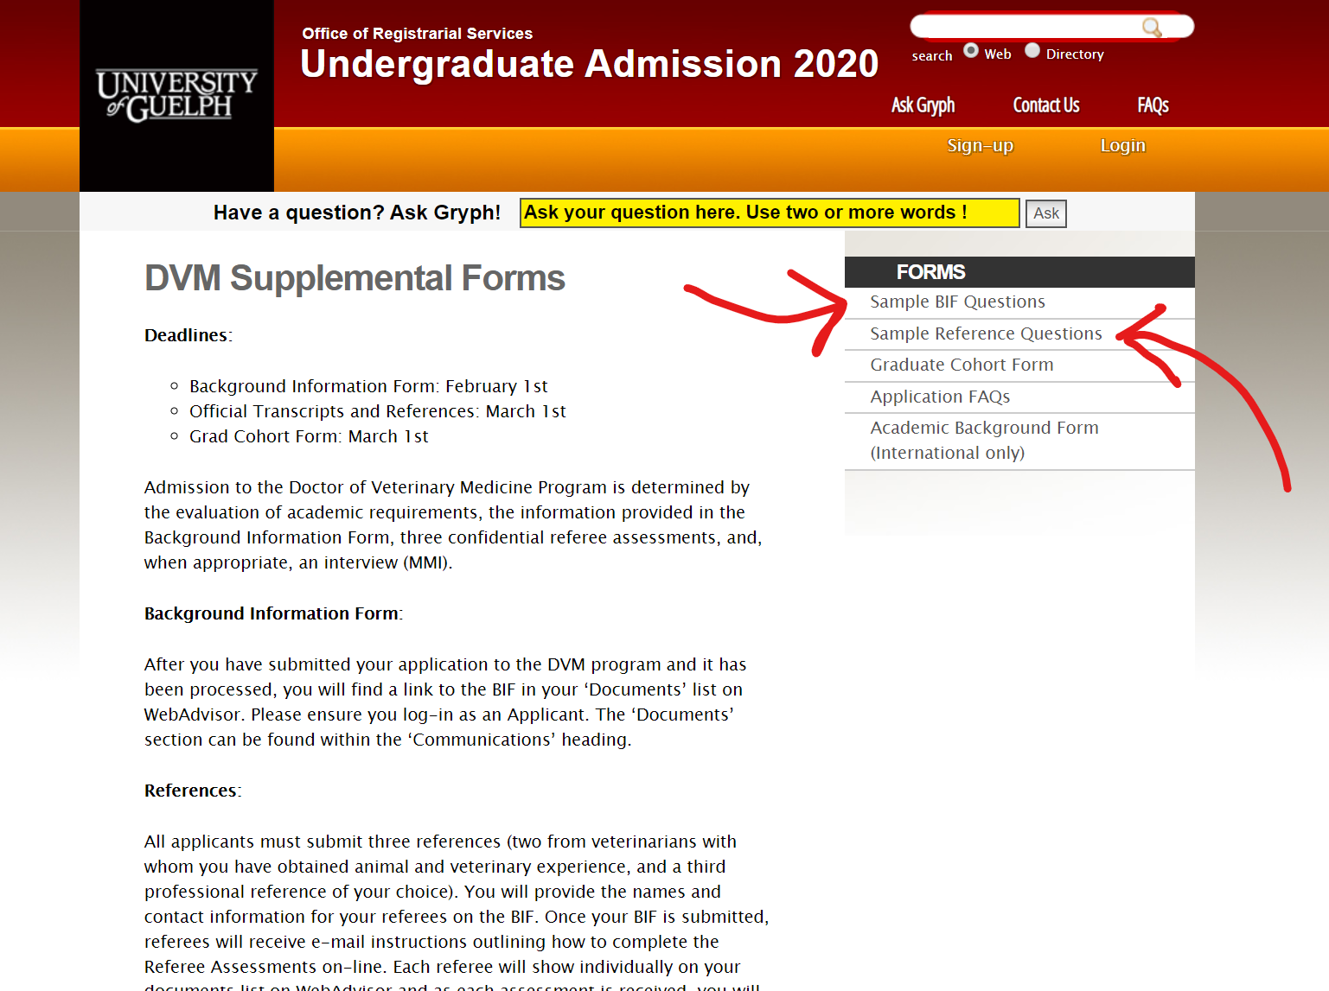
Prep for your BIF & References
https://admission.uoguelph.ca/dvmbif
Look through the Sample Reference Questions BEFORE you ask for references!!
Notes:
Something I didn’t know when I was applying…
You can find the BIF essay Q’s online so you can start working on your answers early (actual application doesn’t become available until sometime in Dec)
It could change but for me the Q’s were the exact same as these ones on the sample form so you can likely write out your answers to these Q’s & just tweak them if the actual Q’s are different
Look through the sample reference Q’s BEFORE asking your referees - that way you can decide whether they know you well enough to write your reference AND when you ask them you can explain what will be expected of them if they agree!!!!

Slide 57
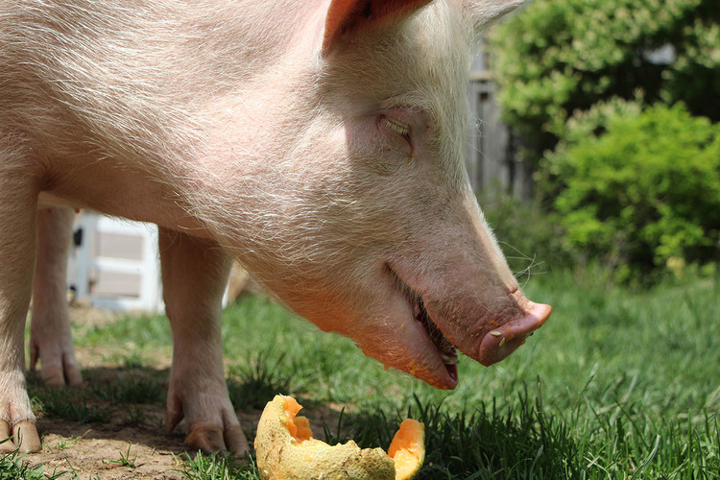
Volunteer Opportunities
Toronto Wildlife Centre
Wildlife experience
https://www.torontowildlifecentre.com/volunteer/volunteer-opportunities/
Wishing Well Farm Sanctuary
Large/Food animal experience
Website currently under construction
Happily Ever Esther Farm Sanctuary
Large/Food animal experience
https://www.happilyeveresther.ca/volunteer
Notes:
I personally got some large animal experience at Wishing Well Sanctuary in Bradford but I’m not sure if Wishing Well is currently taking new volunteers, they recently underwent a large restructuring

Slide 58
Final Tip...
Be confident! Make sure your supervisors/peers know you want to be a veterinarian!

Slide 59
Talks by Elizabeth Lowenger...
https://www.youtube.com/watch?v=Ns7BtPe-GrE

Slide 60
New this year...
https://www.youtube.com/watch?v=Ph5LdGZBeps
Notes:
Haven’t personally seen it yet but it may have more helpful advice than the 2014 talk.

Slide 61
Questions?

